Slide 1
Ancient mythology search application Using semantic web technologies
D Srinivas
2021497

Slide 2
Introduction
Ever since the lockdown has been imposed in the country - Mahabharata Gets 1.9 Billion Views On Doordarshan channel! Gets Highest Ratings Ever For Any Tv Show Since 2015 in India. (Source:Google).
Why this ontology? – To search information of ancient mythology like people,events,chapters.
Who uses this application?
Aim – To create User Interface and implement the semantic data technologies on Ancient Hindu mythology.

Slide 3

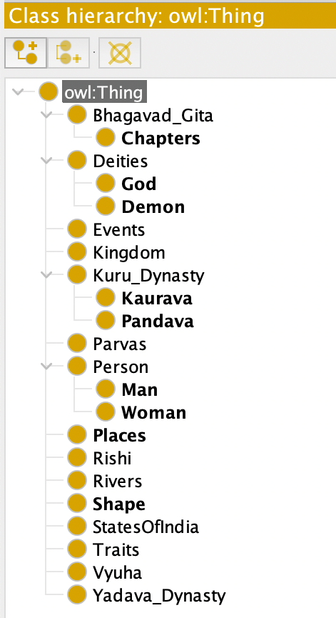



Classes
Some of my classes includes – chapters of book, Person, Deities( gods and demons), Dynasties (Kuru and Yadava), Kingdoms, Events, Places compared to states of India.
There are about 1207 axioms, 22 classes , 33 object properties, 9 data properties, and 249 individuals.

Slide 4

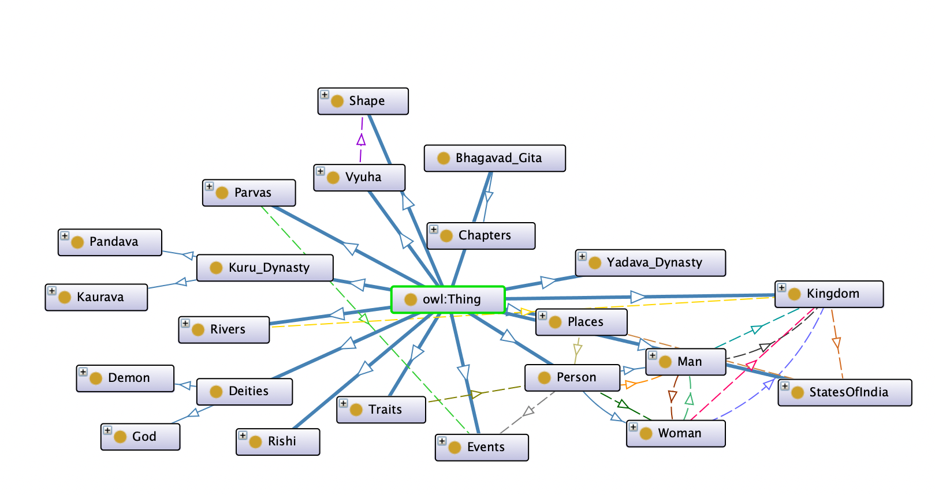
Onto_graf

Slide 5
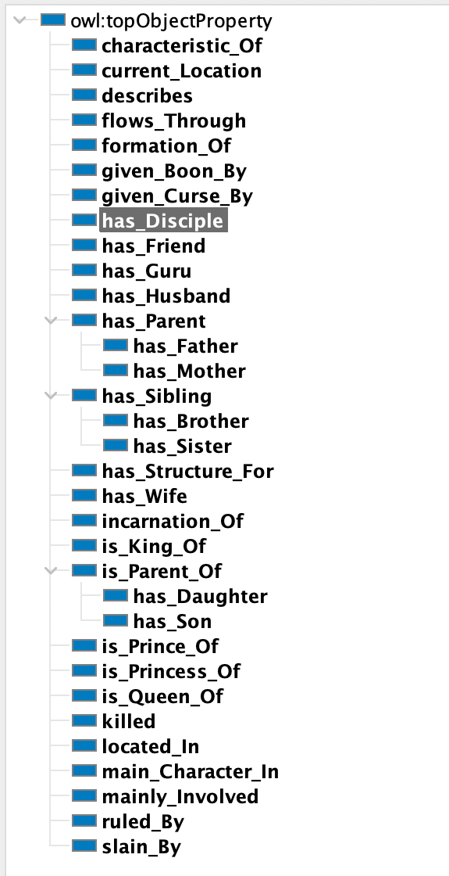
Object Properties
Is_King_of
For example Karna -> Anga
Shakuni -> Gandhar
Characteristic_Of
For example Karna ->archery
Arjuna ->archery, dance
Current_location
For example Indraprastha -> Delhi
Hastinapura -> Uttar Pradesh
Killed and slain_By are inverse object properties.
has_Disciple and has_Guru are Inverse

Slide 6
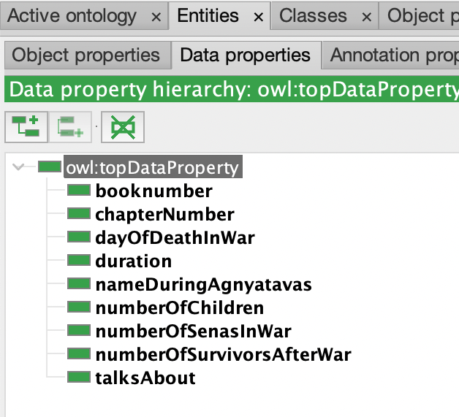
Data Properties
chapterNumber - chapters of the book has chapterNumbers
For example dyan has chapterNumber 6 and karma has chapter number 3
talksAbout - each chapter talks about particular topic in the book
For example dyan chapter talks about self-restrait in book
Duration - Duration is the timespan for a particular event.
For example agynatavas is an event has a duration of one year

Slide 7
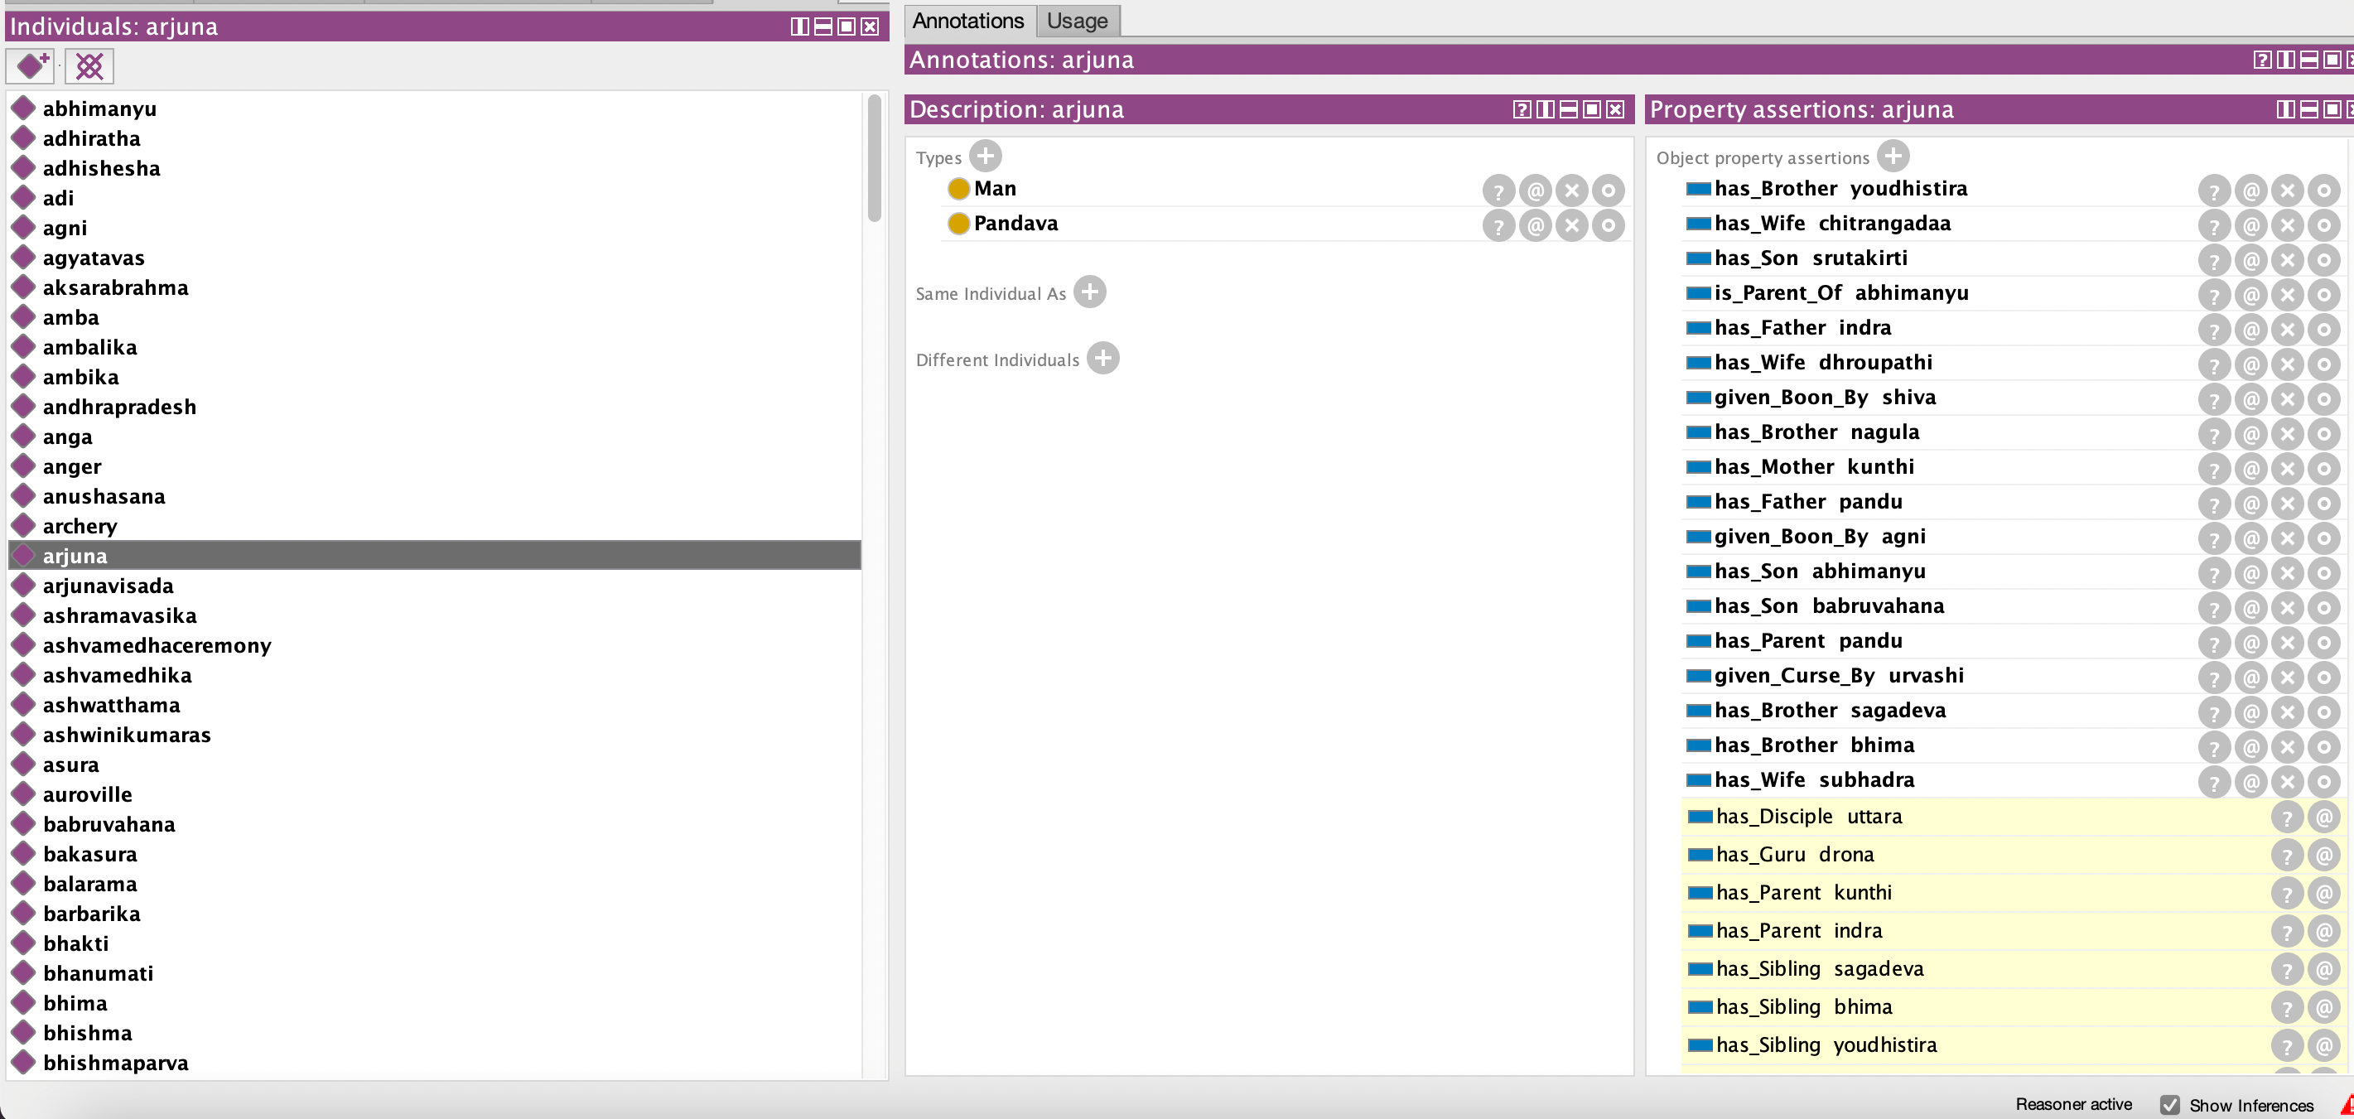
Individuals

Slide 8
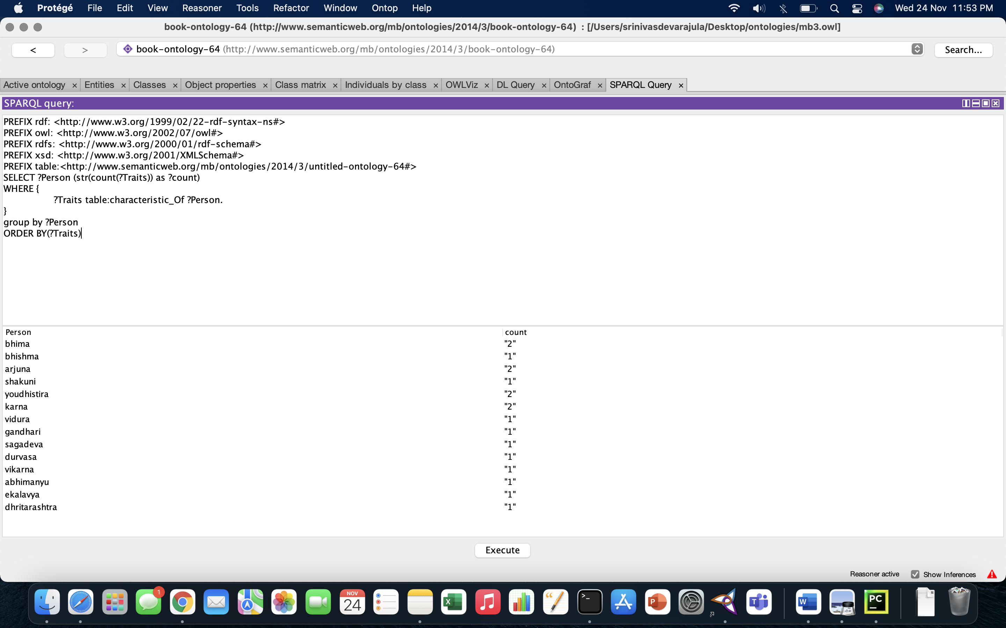
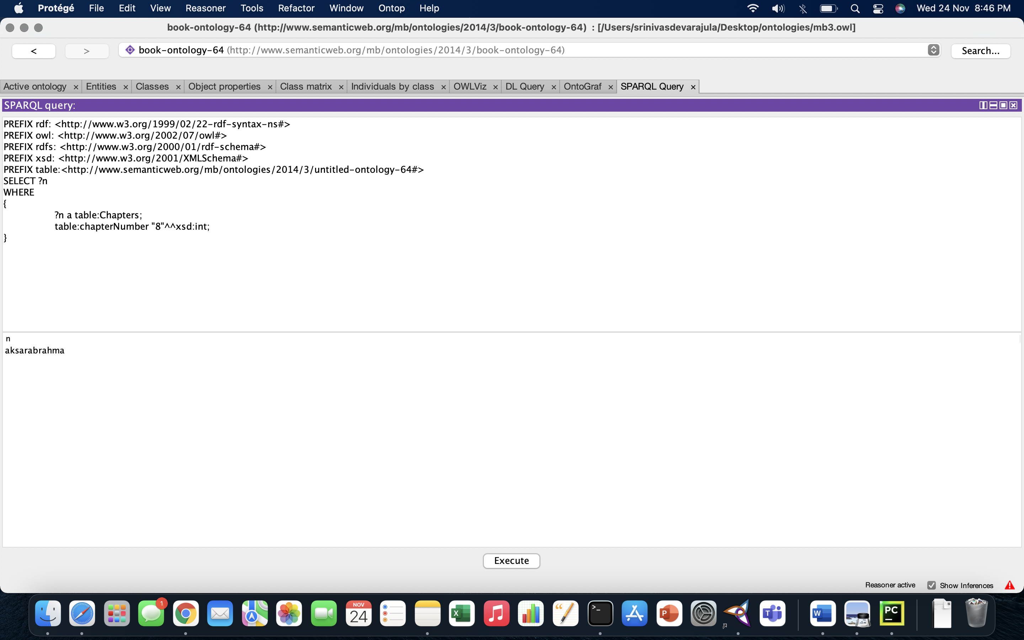
SPARQL Queries
Number of traits for each person.
Chapter search by its unique number

Slide 9
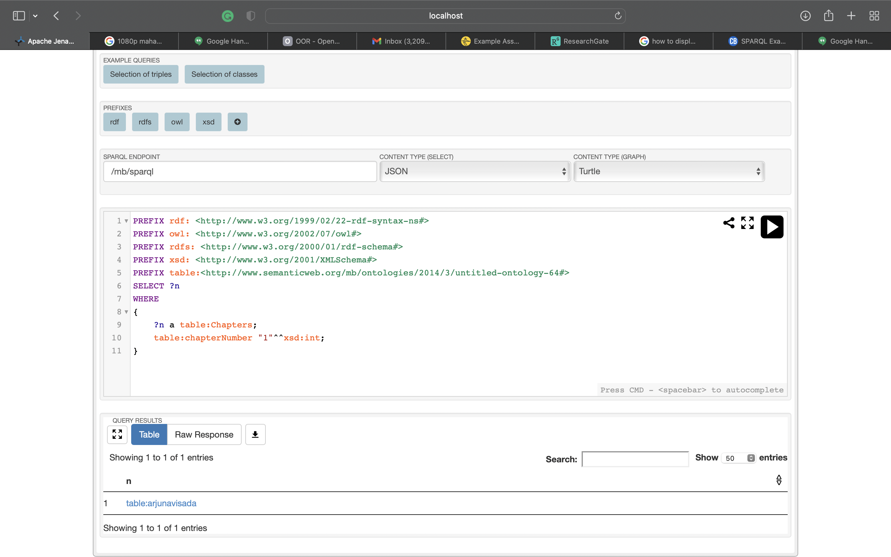
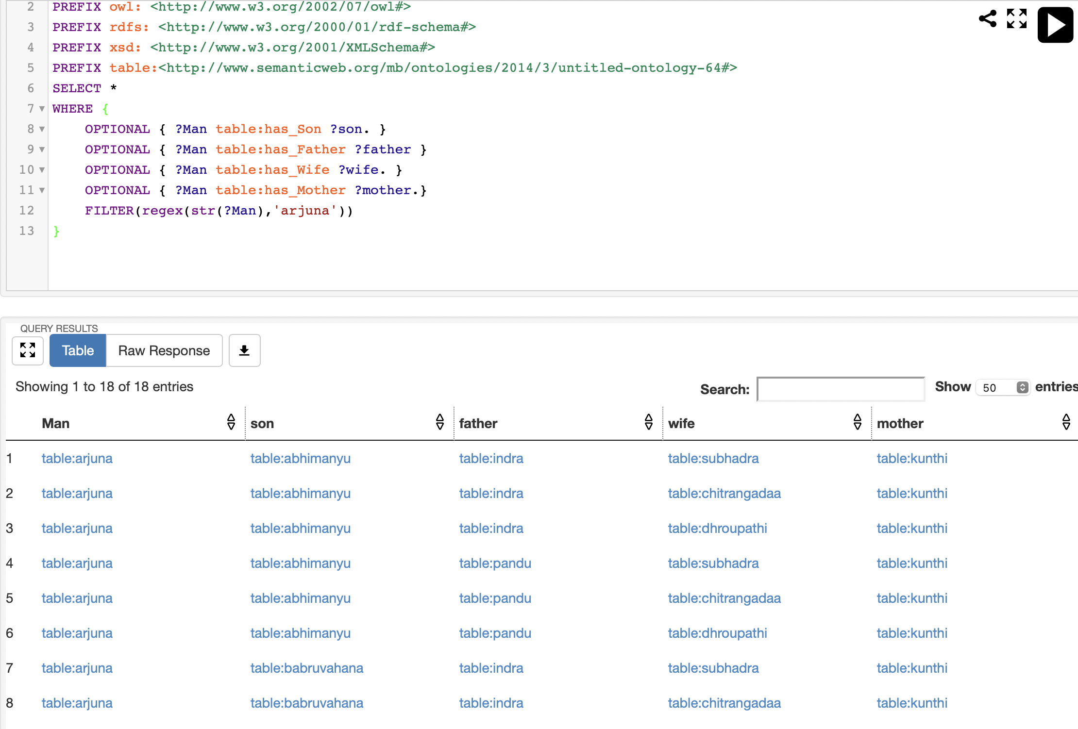
SPARQL Queries
Character search with its relations using filter

Slide 10
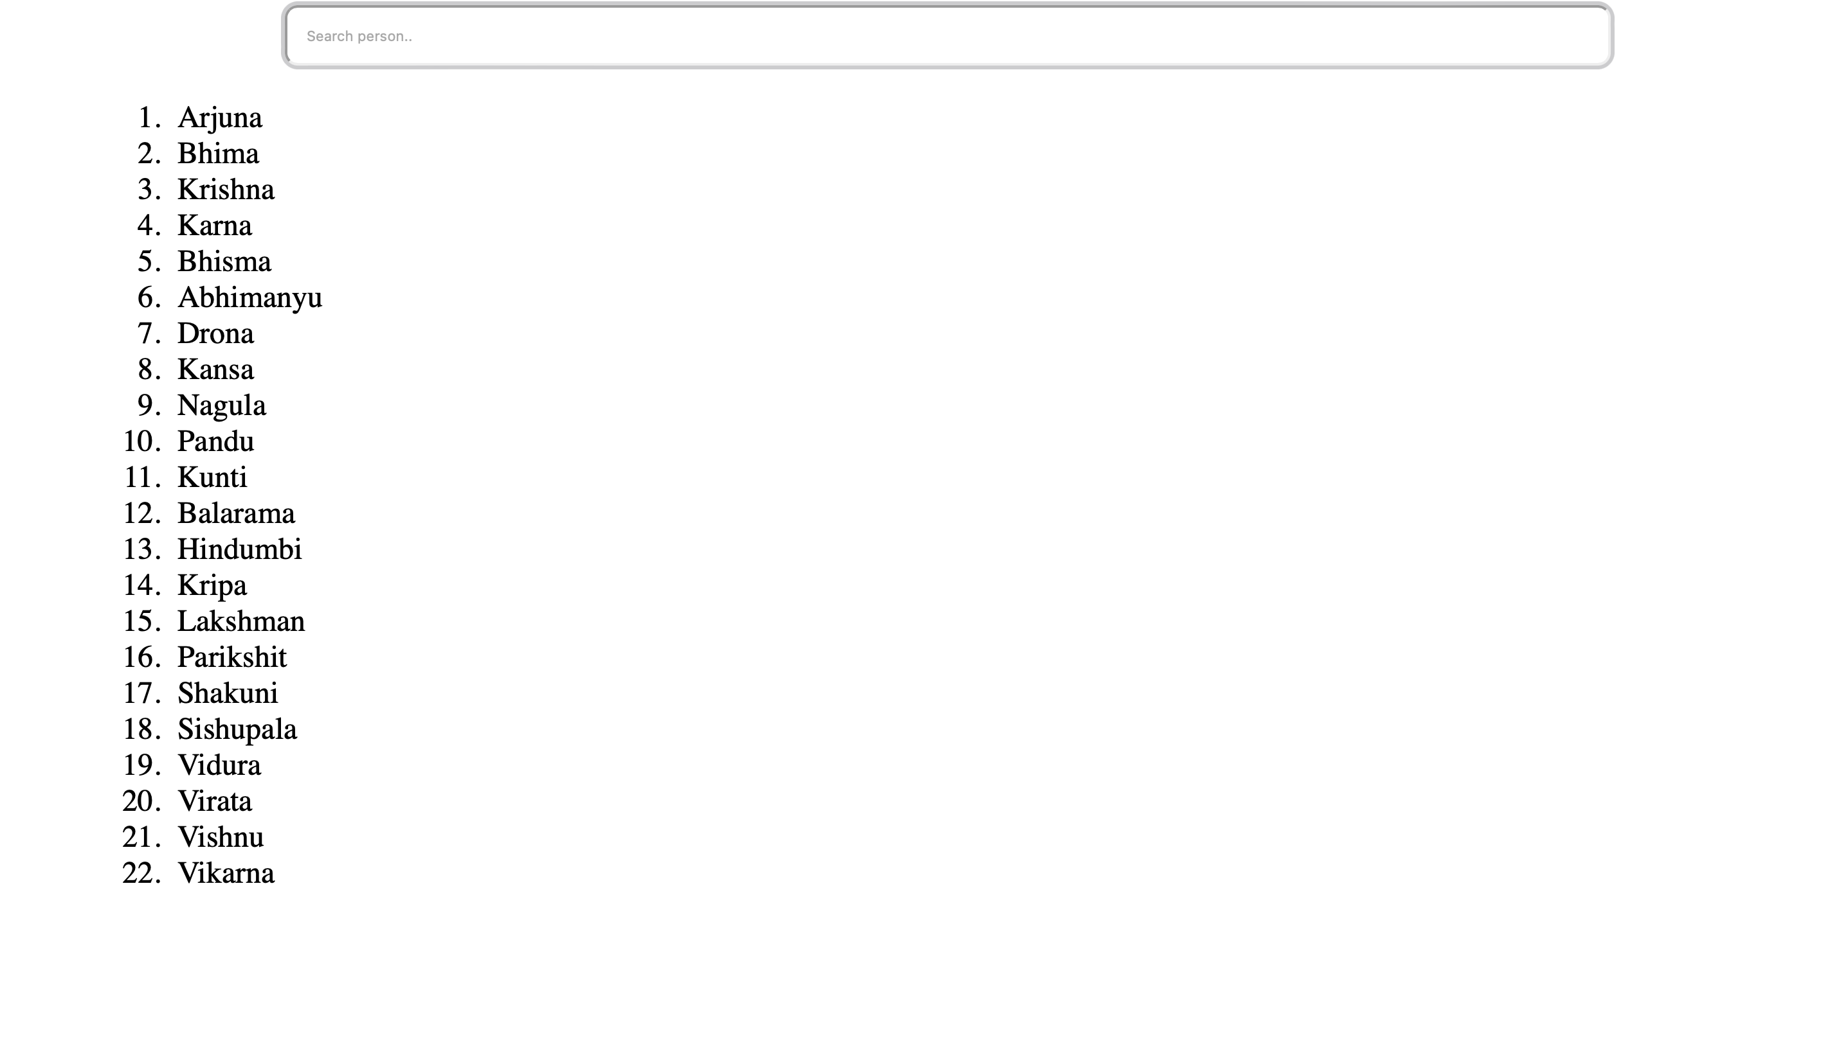
User Interface
My user interface will give the results of all details about a person through character search
It will also give the results about a particular book details in mythology through book search.
Using python Django to implement my search interface.

Slide 11
References
C. Syamili, R.V. Rekha, 2018. “Developing an ontology for Greek Mythology” (online) Available at:< https://www.emerald.com/insight/content/doi/10.1108/EL-02-2017-0030/full/pdf?title=developing-an-ontology-for-greek-mythology>
Berners-Lee, T. (1998),” Semantic Web Road Map” (online) available at< www.w3.org/DesignIssues/Semantic.html>

Slide 12

Thank you Any questions?

